Slide 1
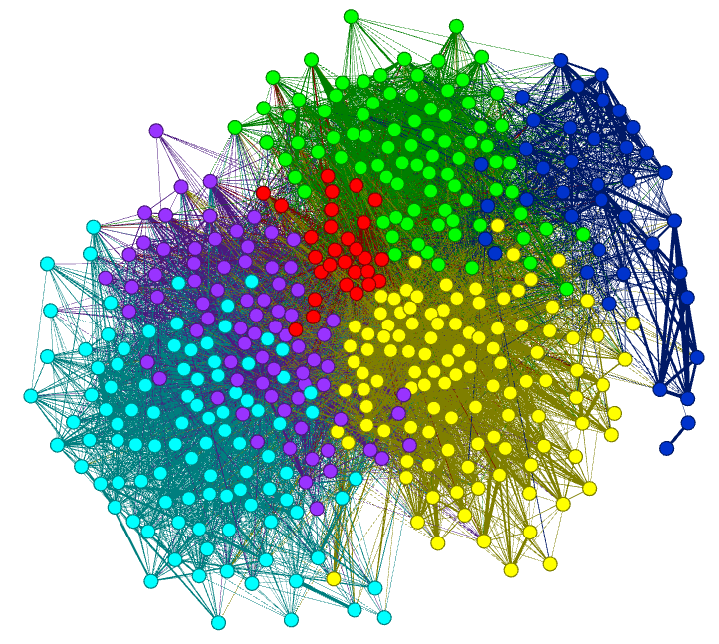
Data Cleaning
gates

Slide 2
Outline
Reminder of Types, Formats, and Model Goals
Introduction to “Cleaning”
Missing Values
Incorrect Values
Duplications
Outliers
Formatting for Models
Transformation
Normalization

Slide 3
Reminder of Types, Formats, and Model Goals
Data can be:
1) Quantitative (numeric) (discrete or contiuous, interval or ratio)
2) Qualitative (ordinal or nominal)
Datasets can be:
1) Record
2) Text
3) Matrix
4) Transaction
5) Sequential
Etc…

Slide 4
Introduction to Cleaning
Data is the beginning of information discovery.
To retrieve information from data, the data must first be prepared, then explored, then analyzed and modeled, and then its information can be presented.
Data cleaning is a cyclic and iterative set of processes that includes exploring, visualizing, updating, formatting, transforming, normalizing, discretization, and correcting data.
Data preparation often also includes steps such as the identification and management of outliers, as well as the generation of new features. These processes are repeated until the data is prepared for analysis, or clean, AND, are different for different goals and data types.

Slide 5
Missing Values
A missing value is a single attribute (variable) observation or value that is not available.
For example, if a dataset has a variable called Age and one of the Age values is missing for one of the rows, this is a missing value.
A missing value may result from a lack of data during collection, such as a survey question left blank, or may result from errors in rendering the data, such as data-entry issues.
Missing values can have a significant impact on the quality of a dataset and on the information that it contains.
If a given column in a dataset contains too many missing values, it may not be a usable variable for analysis.

Slide 6
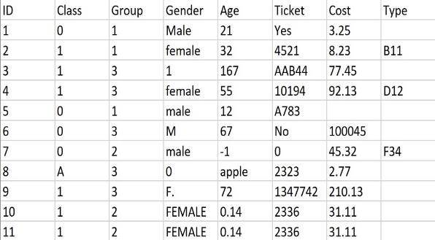
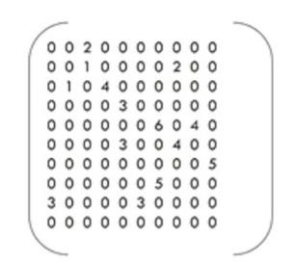
Missing Values: Examples
>gi|2978501|gb|AAC06133.1| vacuolar ATPase proteolipid subunit [Giardia intestinalis] MSSIDSPVAVEKCPAGASFWSMLGQVVAVVFSSIGAAYGTAKAGSGLGV AGLINPAPVTKLTLPVI AGILSIYGLITSLLINSRVRSYTNGMPLYVS YAHFGAGLCCGLAALAAGLAIGVSGSAAVKAVAKQPSLFVVMLIVLIFS EALALYGLIIALIL TKSADSNFCVNNVNQ

Slide 7
Finding Missing Values
Generally (but of course not always) – finding Missing Values can be straightforward.
However, correcting missing values can be difficult or impossible.
Why?

Slide 8
Incorrect Values
Incorrect values are often more challenging to locate within a dataset than missing values.
Unlike missing values, which tend to adhere to a given format, such as blank or NA, incorrect values can be anything.
Therefore, incorrect values must first be discovered.
This is done using code – such as R or Python.
This requires knowledge about the dataset and the domain.

Slide 9
Incorrect Values: Easier
Where are the incorrect values?
How would you FIND them with code?

Slide 10
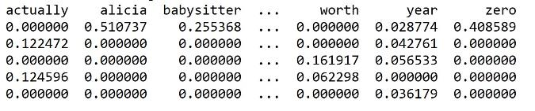
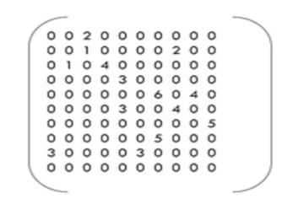
Incorrect Values: Harder
>gi|2978501|gb|AAC06133.1| vacuolar ATPase proteolipid subunit [Giardia intestinalis] MSSIDSPVAVEKCPAGASFWSMLGQVVAVVFSSIGAAYGTAKAGSGLGV AGLINPAPVTKLTLPVIAGILSIYGLITALLINSRVRSYTNGMPLYVS YAHFGAGLCCGLAALAAGLAIGVSGSAAVKAVAKQPSLFVVMLIVLIFG EALALYGLIIALILTKSADSNFCVNNVNQ

Slide 11
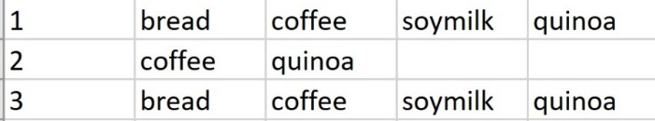
Duplications
Datasets can sometimes have duplicated data.
These duplicates may be true duplicates - errors caused by the same exact data being repeated by accident.
→ To identify a TRUE duplicate, the data row (in record data) must have a primary key. This is a column that is a unique identifier.
Duplicates may NOT be true duplicates.
→ For example, in transaction data, two transactions may be identical, but made by different people.
Can you think of examples of true and not true duplication?
How could you determine this?

Slide 12
Which duplicate are you SURE of and why?
SS# | Name | Age | Hobby
343-39-5674 | Bob | 23 | Hiking
123-45-3737 | Sally | 30 | Swimming
343-39-5674 | Robert | 23 | Hiking
Lastname | Firstname | Hobby | Major
Xu | Jia | Basketball | Math
Wang | Ben | Football | CS
Wang | Ben | Football | CS

Slide 13
Outliers: How do you Define “too different” or “far”.
1) An outlier, while noisy and perhaps incorrect, is in its own data –cleaning category.
2) An outlier is a value that is significantly “far” or “different” from the other values and from what is expected.
Examples:
(a) The value -1 for AGE is incorrect – but NOT an outliers.
(b) The value 125 for AGE is likely incorrect, but also not an outlier.
(c ) However, a value of 13456 is an outlier.
An outlier value is significantly different (non-similar) to expected values.
**The concept of significantly different requires a measure of similarity.

Slide 14
Outlier Definition: Nope!
There is no universal definition for an outlier.
Common definitions include:
- an observation that differs so much from other values that it raises suspicion (Hawkins, 1980), or
- an observation that appears to be very inconsistent with the other data (Barnett and Lewis, 1994).
In both of these definitions, the notion of an outlier is that it is rare (so very few or just one data point), and very different (far) from all the other data points.
However, even the idea of “different” is based on a measure of similarity or distance, and different distance measures can offer different results.

Slide 15
Finding Outliers?
1) This depends on the nature of the data.
2) This depends on knowledge of the domain.
3) This depends on measures of “distance” or “similarity”
Different might mean NEW and not WRONG!
Methods:
1) Outside of known ranges (such as with AGE).
2) Outside of +/- 3 st. dev from the mean (if close to normal and numeric)
3) Outside of all clusters…
ETC…

Slide 16
Formatting for Models
Cleaning is NOT the same for all methods and models and is NOT the same for all data types.
1) Cleaning data to use with an SVM will be different than for DT or NB, or R, or Python, or text data, or sequential data…etc.
2) The same dataset may be cleaned, prepared, formatted, etc. DIFFERENTLY for each model or method it will be applied to.

Slide 17
Transformation
The look or expression of data can be altered without destroying its relative integrity.
1) Math Transformations:
- Sqrt
- Log
- Square, cube, …
- kernel
2) Discretization:
- Binning
- Conversion to Binary
- Aggregation

Slide 18
Normalization
Example:
Suppose California has 1000 cases of Covid and New Hamshire has 500.
Which state needs support first?

Slide 19
Normalization Methods
1) TEXT
- Tf-Idf
- Division across rows by the total number fo words
2) RECORD
- Change “counts” to “relative frequencies”.
- Use the z-value to compare variables with different means and std devs.
- Use min-max to force all values between any two values (such as between 0 and 1)
Example:
There are 15 sections of ANLY 501. Each section has a different number of students. All sections awarded 5 A grades. Which teacher gave the most A grades? How can you tell?

Slide 20
Sampling and Subsetting
Not all variables or parts of a dataset can be used with all methods or models.
1) In some cases, only the quantitative (numeric) data can be used.
This is true for SVM, NB in Python (with the common library), clustering with k-means.
2) In some cases, one might choose to look at only categorical data – such as with DT, NB (in R), and ARM.
3) Often, datasets are so large, that samples or subsets are used to create and test models before the entire dataset is applied.

Slide 21
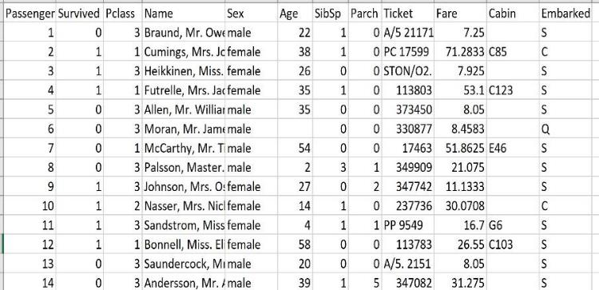
Aggregation
Columns (variables) in record data can be aggregated (combined using a function) so as to create a new column and/or reduce dimensionality.
Example: What can we aggregate here?

Slide 22
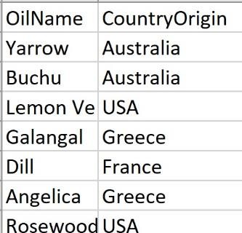
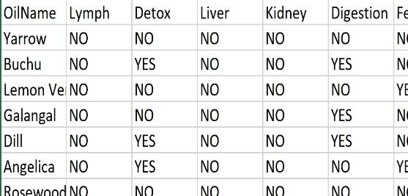
Joining (Combining Datasets)
It is often necessary to combine datasets so as to build more robust models and/or more descriptive visualizations.
For example – how might you JOIN these two datasets and why?

Slide 23
Feature Generation and Data Harmonization
It is often the case that multiple datasets are utilized in data analysis.
They may have arisen from different sources and may have different formats and naming conventions.
Harmonizing data involves blending and combining multiple datasets together such that all information is properly retained and represented.
Feature generation (also known as feature engineering) is the process of creating new variables (or features) using the current variables in the dataset.
New features may be created through discretization, the application of a function, or the alteration of a format.

Slide 24
Feature Generation Example
Example:
Suppose a dataset contains the variable DateOfBirth.
This is important information, but will create a challenge when performing analysis.
However, the DateOfBirth variable may be used to generate a new feature (column) called Age, which is created using a function that subtracts the date of birth from the current date.
DateOfBirth is a “date” type and is not quantitative.
Age is a numeric data type that can be used more broadly in analyses.

Slide 25
Remapping
1) Words to numbers…
Example 1: Text data to tokenized and vectorized frequency count dataframe.
Example 2: Male and Female mapped to 0 and 1.
Example 3: Theatre Ticket cost (quantitative) mapped to an ordinal variable (such as Group1, Group2, and Group3 – this is discretization).
Example 4: Converting qualitative values to quantitative values via weights.

Slide 26
Example1: remapping
Label | Numeric remap
Single | 0
Divorced | .25
Widowed | .5
Remarried | .75
Married | 1
Label | Numeric remap
English | 0
French | 1
Spanish | 2
Mandarin | 3

Slide 27
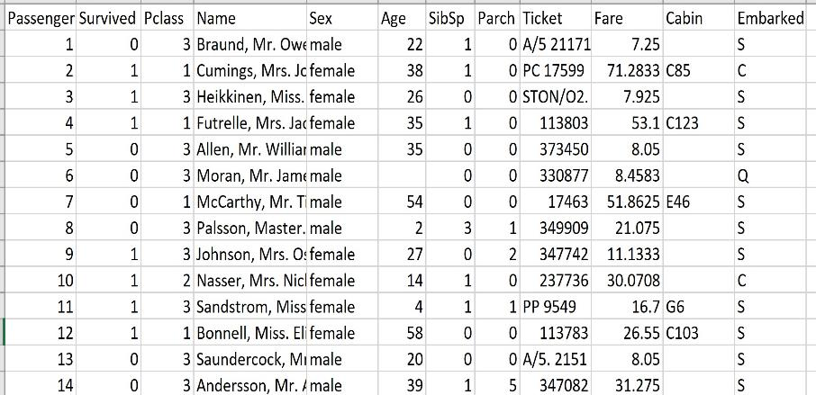
Example 1: Titanic (Kaggle)

Slide 28
Missing Values
Options for correction:
Replacing with a measures such as the mean, median, or mode.
What are some concerns with this?
When should rows be removed?
When should columns be removed?
How can the BEFORE and AFTER be measured?

Slide 29
Incorrect Values
What can be done?
What are issues?
How can BEFORE and AFTER be measured?
What are examples of incorrect values?

Slide 30
Format Issues
Example:
Suppose a variable is Gender.
Suppose the data is:
M, M, F, F, F, M, F, 0, M, F, 1, Female, M, MALE
What can be done here?
How can Python be used to do it?

Slide 31
Value re-assignment - Normalization
Normalization:
Every dimension (attribute) is constructed so that its maximum and minimum values are the same.
Typically 0 is the minimum and 1 is the maximum. This creates a unit state space.
Linear scaling (Min-Max Normalization)
x_{normalized} = x_{i}-min(x₁…x_{n})
max(x_{i}…x_{n}) - min(x₁…x_{n})
where x_{i} = the i^{th} value of the variable

Slide 32
Value re-assignment – Normalization cont.
Z-Score standardization
x_{normalized} = x_{i} - mean
standard deviation
Decimal scaling
x_{normalized} = x_{i} / 10^{j}
where j is the smallest integer such that Max(|x_{i}|) < 1
Normalizes by moving the decimal point

Slide 33
Normalization - Know What You Are Doing and Why.
 | hike | mountain | dog | coffee
Doc1 | 3 | 4 | 0 | 11
Doc2 | 1 | 10 | 4 | 3
Doc3 | 10 | 5 | 11 | 5
Doc 1 has 1000 words in it.
Doc 2 has 100 words in it.
Doc 3 has 100,000 words in it.
Should you normalize? How?

Slide 34
Outliers?
An outlier is a value or an observation that is distant (far or dissimilar) from other observations,
→ A data point (row or vector) that differs significantly from other data points.
Is an Outlier:
1) A mistake?
2) An extreme or different value that is unusual but correct?
→ There is no strict or unique rule that says that outliers should be removed from a dataset.
→ What should you do? How should you find outliers?
Deep Reference: http://www.eng.tau.ac.il/~bengal/outlier.pdf

Slide 35
The NASA Ooops of Outliers
http://www.realclimate.org/index.php/archives/2017/12/what-did-nasa-know-and-when-did-they-know-it/
A machine collecting data on the ozone removed extremely low values because it logged them as outliers.
In fact, there were correct and represented a hole in the ozone layer.
Is it OK to remove outliers? Sometimes.
Are there rules for removing outliers? No.
Can an outlier represent a true datapoint? Yes.

Slide 36
Outliers and R: Example
https://drive.google.com/file/d/19asjLgGxwGF9bCTSKUwLtXdzCLC7f62m/view?usp=sharing
Including IQR, Vis, Grubbs, and more….

Slide 37
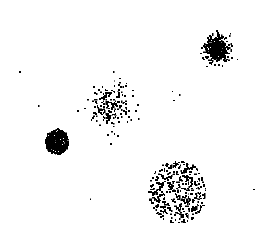
Outliers
Outliers are data objects with characteristics that are considerably different than most of the other data objects in the data set

Slide 38
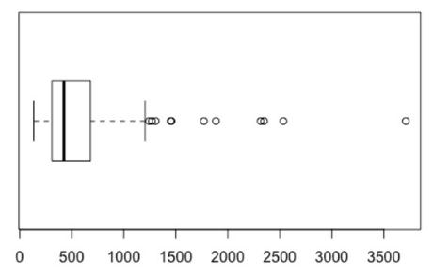
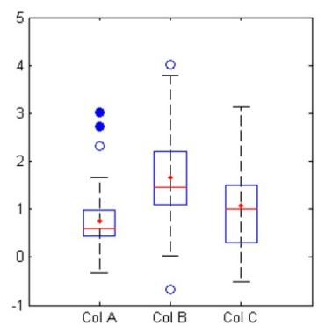
Example 1: Visualizing Outliers Boxplots and IQR
http://wiki.eigenvector.com/index.php?title=Boxplot

Slide 39
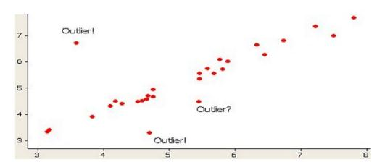
Example 2: Visualizing Outliers Scatterplots
https://conversionxl.com/blog/outliers/

Slide 40
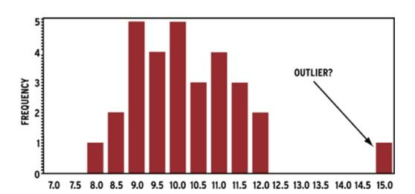
Example 3: Visualizing Outliers Histograms

Slide 41
Outliers
Extreme values that lie near the limits of the data range or go against the trend of the remaining data.
Example:
2, 3, 7, 9, 1000, 4, 5
Important: Outliers are not always wrong!

Slide 42
Outlier detection using IQR
The IQR is defined as the difference between the upper quartile and the lower quartile of a data set, sometimes written as Q3 - Q1.
A data value is an outlier if:
It is 1.5(IQR) or more below Q1
It is 1.5(IQR) or more above Q3

Slide 43
Grubbs: About
What is Grubbs’ Test for Outliers?
Grubbs’ test is used to find a single outlier in a normally distributed data set. The test finds if a minimum value or a maximum value is an outlier.
Cautions:
The test is only used to find a single outlier in normally distributed data (excluding the potential outlier). If you think that your data set has more than one outlier, use the generalized extreme studentized deviate test or Tietjen-Moore test instead.
Using this test on non-normal distributions will give false results.
Run a test for normality (like the Shapiro-Wilk test) before running Grubbs’ test. If you find your data set isn’t normally distributed, try removing the potential outlier from the data set and running the normality test again. If your data still isn’t normal, don’t run this test.
https://www.statisticshowto.com/grubbs-test/

Slide 44
Grubbs By Hand
Find the G test statistic.
Find the G Critical Value.
Compare the test statistic to the G critical value.
Reject the point as an outlier if the test statistic is greater than the critical value.
Ho: There is no outlier
Ha: There is an outlier

Slide 45
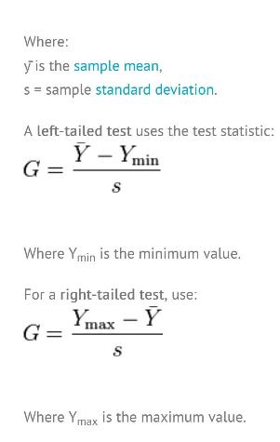
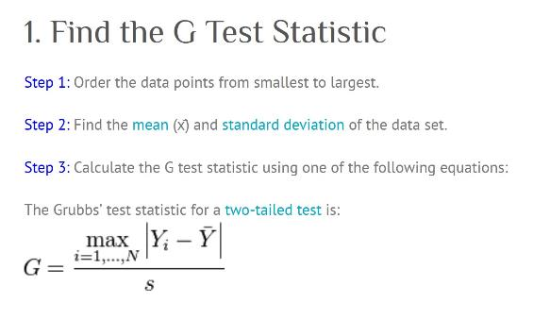
Grubbs Test

Slide 46
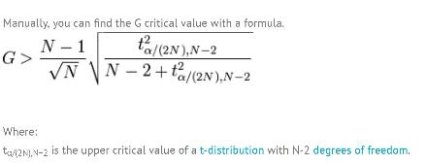
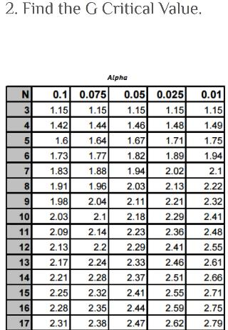
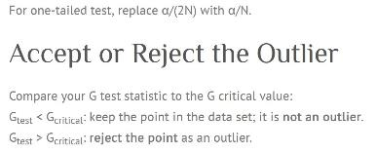
Grubbs Test

Slide 47
Other Examples of Noise
Random error or variance in a measured variable.
Examples:
Audio (voice poor quality on phone)
Video (“snow on TV)
Sensor noisy
Survey data collection by different people
Noisy values may be due to:
Faulty data collection instruments
Data entry problems
Data transmission problems
Technology limitations
Inconsistent naming conventions

Slide 48
Noisy Tweets: What is noise?
#ISIS is the end of human slavery! #IslamicState
OMG check this out: http://t.co/g5fmtC0GPJ
Brother Abu Suhaib Al Jazrawi May Allah accept him #ISIS #IslamicState 💕 💕 😔 😔 http://t.co/g5fmtC0GPJ
a crowded fruit & vegetable market in Jarablus, #Aleppo #IslamicState #IS #ISIS #MessageToIsis
If it's not clear to you at this point that twitter is allowing #ISIS to terrorize people you're a fool
Notes:
Tweet 2 is spam

Slide 49
How to Handle Noisy Data?
Binning method
Looked at neighborhood and locally smooth data.
Regression
Smooth by fitting the data into regression functions
Clustering/Anomaly Detection algorithms
Detect and remove outliers
Combined computer and human inspection
Detect suspicious values and check by human and then build a classifier

Slide 50
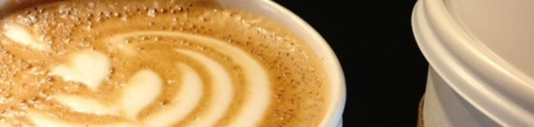
Binning
54.876985
63.345339
52.478001
62.047462
59.692849
63.116668
52.394022
60.539069
56.14605
56.553081
57.899076
59.550554
61.852781
55.549742
50.020629
62.877525
60.620873
54.269527
50.999137
59.763285
61.565763
Example Dataset: height in inches
(65 – 50) /6 = 15/6 = 2.5 So, the WIDTH of each bin is 2.5.
Height | Range | Absolute Frequency | Relative Frequency | Cumulative Frequency
Bin 1 | 50 – 52.5 | 4 | 4/21=19.1% | 19.1%
Bin 2 | 52.5 - 55 | 2 | 2/21=9.5% | 19.1%+9.5%
Bin 3 | 55 – 57.5 | 3 | 3/21=14.3% | 19.1%+9.5%+14.3%
Bin 4 | 57.5 - 60 | 4 | 4/21=19.1% | 19.1%+9.5%+14.3%+19.1%
Bin 5 | 60 – 62.5 | 5 | 5/21=23.8% | 19.1%+9.5%+14.3%+19.1%+23.8%
Bin 6 | 62.5 - 65 | 3 | 3/21=14.3% | 19.1%+9.5%+14.3%+19.1%+23.8%+14.3%
Total |  | 21 | 100% | 100%

Slide 51
Bar Graph of binned data

Slide 52
Regression Equation Smoothing
Smooth by fitting the data into regression functions
Two approaches:
First remove outliers and then update values to fit regression line
Do not remove outliers and update values to fit regression line

Slide 53
Regression Equation Smoothing
1) Clean Data Equation
2) No outliers removed:
Equation is…
One Outlier removed (30):
Equation is…
x y
1 13
2 12
3 14
4 30
5 18
6 19

Slide 54
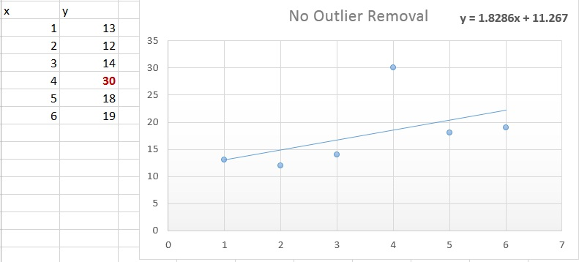
Outliers Not Removed

Slide 55
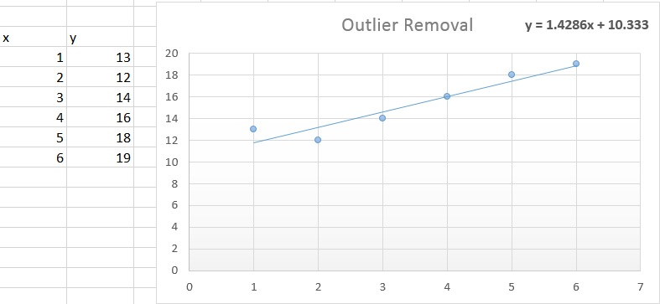
Outlier Removed (30 removed)

Slide 56
Other Measures
Correlation r: Measures the reliability of linear relationship between two variables.
x and y.
Covariance: Measure the amount dimensions (attributes/variables) vary from the mean with respect to each other.

Slide 57
More On Missing Values
Reasons for missing values
Information is not collected
Attributes may not be applicable to all cases
Equipment malfunction
Not important at time of data entry
Handling missing values
Ignore the missing value during data analysis
Eliminate data objects
Fill in each missing value manually
Estimate missing value with global constant (mean or mode)
Replace with all possible values (weighted by their probabilities, e.g. use most probably value)
Randomly select based on regression line

Slide 58
Maintaining Original Knowledge
When replacing a missing value - make sure to note that the value was originally missing - using a different attribute.
For each variable in the data set, we set a flag for present or empty. Creating such flags has a series of patterns.
While we may not do this in class – it is often critical when cleaning data for a company or job.
Also – always retain the original raw data.

Slide 59
Unbiased Estimator
A method for guessing a value of a particular attribute without changing important characteristics of the values in the data set.
Statistically, an unbiased estimator produces an estimate whose expected value is the value that would be estimated from the population.
Using the mean to replace a missing or incorrect value - what is the benefit and what is the risk?
Using the median to replace a missing or incorrect value - what is the benefit and what is the risk?

Slide 60
To Note:
The missing value estimate depends as much on which characteristic is to be unbiased as it does on the actual value. Therefore, we need to determine which relationships need to be preserved, both within and between variables.
If many missing values are replaced with the mean, the confidence level for statistical inference will be overoptimistic since the spread of the data will be reduced.
It is better to replace the value with random draws from the variable distribution observed. This means that the values will draw proportionally to the distribution and the center and spread should remain close to the original.

Slide 61
Example
Position | Original Sample | Position 11 Missing | Position 1 Missing
1 | 0.0886 | 0.0886 | ?
2 | 0.0684 | 0.0684 | 0.0684
3 | 0.3515 | 0.3515 | 0.3515
4 | 0.9874 | 0.9874 | 0.9874
5 | 0.4713 | 0.4713 | 0.4713
6 | 0.6115 | 0.6115 | 0.6115
7 | 0.2573 | 0.2573 | 0.2573
8 | 0.2914 | 0.2914 | 0.2914
9 | 0.1662 | 0.1662 | 0.1662
10 | 0.4400 | 0.4400 | 0.4400
11 | 0.6939 | ? | 0.6939
Mean: 0.4023
STD: 0.2785
Mean: 0.3731
STD: 0.2753
Mean: 0.4336
STD: 0.2723
Mean: 0.3731
STD: 0.2612
Mean: 0.4336
STD: 0.2584

Slide 62
Key Ideas
A key point is that although the replacement values are predictions, it is not the accuracy of these predictions that is of most importance.
The key concern is that the predictions produce a workable estimate that least distorts the values that are actually present.
The purpose of replacing the missing values is not to use the values themselves, but to make available the information that is available in the other variables’ values that are present.
If the missing values are not replaced, the whole instance may have to be ignored.

Slide 63
Linear Estimation
In a linear relationship, if the value of one variable changes a certain amount, the value of another variable changes by another certain amount in a specific direction.
In practice, assuming a linear relationship for missing data determination introduces very little bias.
The purpose of replacing missing values is not to use the values themselves, but to make available the information contained in the other variable-values that are present. If the missing values are not replaced, the whole instance may be ignored.

Slide 64
Other missing value advanced approaches: FYI
Nonlinear submodels
Neural networks
Nearest neighbor estimators

Slide 65
Aggregation
Combining two or more attributes (or objects) into a single attribute (or object)
Purpose
Data reduction/dimension reduction
Reduce the number of attributes or objects
Change of scale
Cities aggregated into regions, states, countries, etc
More “stable” data
Aggregated data tends to have less variability

Slide 66
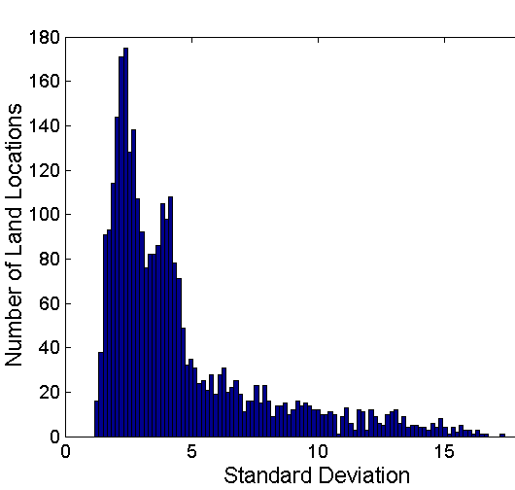
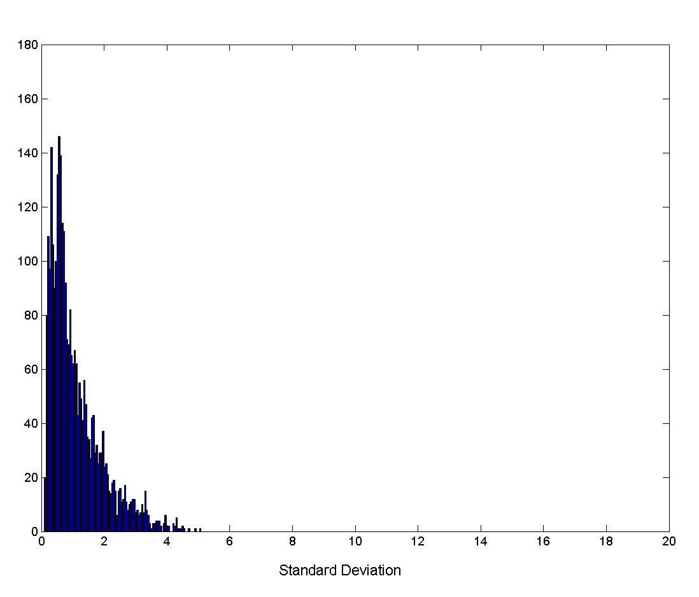
Aggregation
Variation of Precipitation in Australia
Standard Deviation of Average Monthly Precipitation
Standard Deviation of Average Yearly Precipitation

Slide 67
Sampling
Sometimes (often) it is not possible to obtain all the data for a population. When this happens, you need a sample of data.
Sometimes it is not possible to run a data mining algorithm on all the data. When this happens, you need a sample of data.
How do we choose a representative sample?

Slide 68
Sampling cont.
We need to choose a representative subset of the data
A Random sample:
Any sample where each member of the population has a calculable, non-zero chance of selection.

Slide 69
Types of Sampling
Simple Random Sampling
There is an equal probability of selecting any particular item
Sampling without replacement
As each item is selected, it is removed from the population
Sampling with replacement
Objects are not removed from the population as they are selected for the sample.
In sampling with replacement, the same object can be picked up more than once
Stratified sampling
Split the data into several partitions; then draw random samples from each partition

Slide 70
Sampling example - random
Simple random sampling may have very poor performance in the presence of skew
Raw Data
Random Data
Notes:
Simple random sampling may have very poor performance in the presence of skew

Slide 71
Sampling With Replacement
SRSWOR
(simple random
sample without
replacement)
SRSWR
Raw Data
Notes:
What do we feel the effect of this is?
Here we have nine items – 1/9th chance of picking one
With replacment – always a 1/9th chance of picking one
Without replacement – probability changes with each selection. 1/9th chance first, 1/8th chance next , etc.
What does this mean?
With replacement – the two samples are independent. What we get the first time does not affect what we get the second time (covariance is 0)
Without replacement – what we get the first time affects what we get the second time (this can be a problem because it complicated computations. But the covariance does depend on population size. So if the population is large, the covariance will be close to zero. So sampling with replacement (infinite population) is not much different from sampling without replacement (finite population).
Can use the central limit theorem to determine a sufficient sample size for estimating a function with a specified degree of error.
Determining sample size

Slide 72
Adaptive Sampling Methods
Stratified sampling:
The population is divided into non-overlapping groups (strata). Samples are drawn from each strata separately and the results are pooled together.
Approximate the percentage of each class (or subpopulation of interest) in the overall database
Used in conjunction with skewed data

Slide 73
Stratified Sampling
Raw Data
Cluster/Stratified Sample

Slide 74

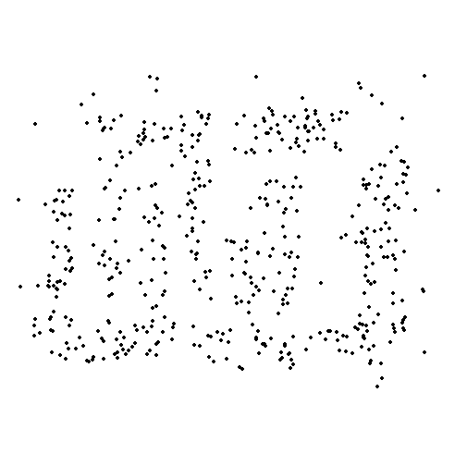
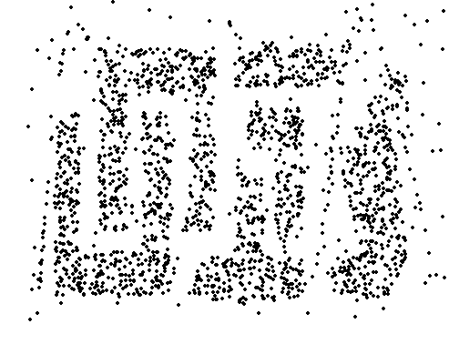
Sample Size Example
8000 points 2000 Points 500 Points
Notes:
Representative also means a sufficient size sample

Slide 75
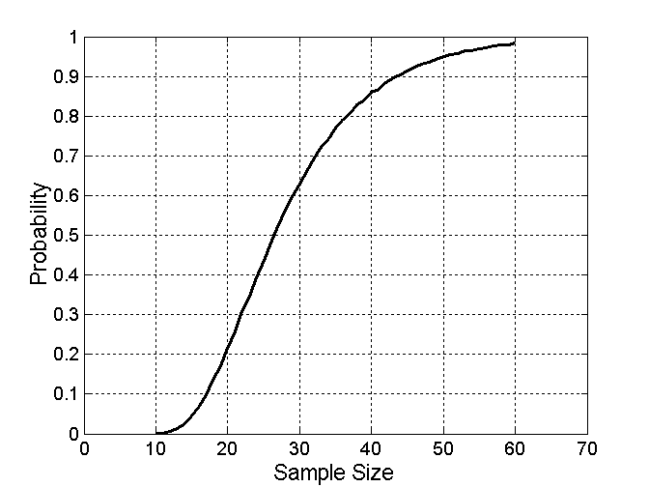
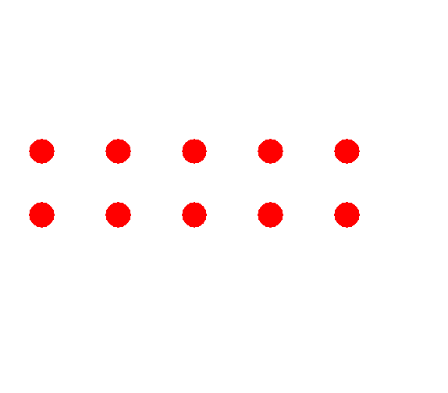
Sample Size
Suppose you have 10 groups with 10 items in each group
What sample size is necessary to get at least one object from each of 10 groups (choosing randomly)?

Slide 76
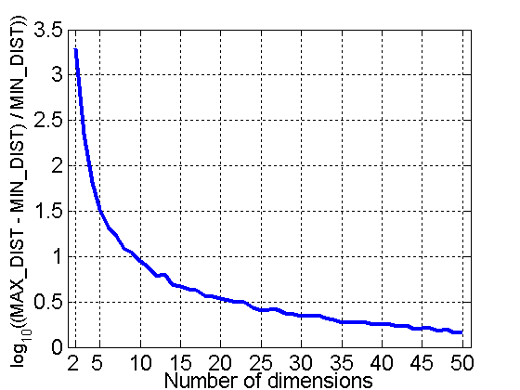
Curse of Dimensionality
When dimensionality increases, data becomes increasingly sparse in the space that it occupies
Definitions of density and distance between points, which is critical for clustering and outlier detection, become less meaningful
Randomly generate 500 points
Compute difference between max and min distance between any pair of points

Slide 77
Dimensionality Reduction
Purpose:
Avoid curse of dimensionality
Reduce amount of time and memory required by data mining algorithms
Allow data to be more easily visualized
May help to eliminate irrelevant features or reduce noise
Techniques
Principle Component Analysis (PCA or ICA)
Singular Value Decomposition (SVD)
Others: supervised and non-linear techniques
Removing non- critical variables or parameters by hand.

Slide 78
Dimensionality Reduction: PCA
Goal is to find a projection that captures the largest amount of variation in data. Here – can you reduce 2D to 1D? How? What is lost?
x₂
e
x₁
Notes:
Find the eigenvectors of the covariance matrix
The eigenvectors define the new space

Slide 79
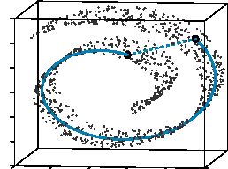
Nonlinear Dimensionality Reduction: ISOMAP
Construct a neighbourhood graph where each point is connected to its k nearest neighbours.
For each pair of points in the graph, compute the shortest path distances – geodesic distances
Use distances to compute a lower dimension embedding
Tenenbaum, de Silva, Langford (2000)

Slide 80
Feature Subset Selection
Another way to reduce dimensionality of data is to remove features that are redundant or irrelevant.
Doing so also reduces overfitting, reduces training time for machine learning algorithms, and may improve accuracy of algorithms.
Redundant features
Duplicate much or all of the information contained in one or more other attributes
Example: purchase price of a product and the amount of sales tax paid
Irrelevant features
Contain no information that is useful for the data mining task at hand
Example: students' ID is often irrelevant to the task of predicting students' GPA

Slide 81
Approaches for Feature Subset Selection
Brute-force approach:
Try all possible feature subsets as input to data mining algorithm
Embedded approaches:
Feature selection occurs naturally as part of the data mining algorithm. Which features contribute most to high accuracy of algorithm.
Use regularization methods, e.g. LASSO
Filter approaches:
Features are selected before data mining algorithm is run by applying a statistical measure and assigning a score to each feature.
Methods: Chi squared test, information gain
Wrapper approaches:
Use the data mining algorithm as a black box to find best subset of attributes
Consider feature selection a search problem in which different combinations are evaluated and compared to each other.
Example: Recursive feature elimination algorithms

Slide 82
Feature Creation
Create new attributes that can capture the important information in a data set much more efficiently than the original attributes
Three general methodologies:
Feature Extraction
domain-specific
Mapping Data to New Space
Transform data to a different space, e.g. Fourier transform
Feature Construction
combining features

Slide 83
Feature Extraction Example
Suppose you are building a classifier that determines how many syllables are in a word.
What features would be useful to extract/create?
Here are a few possibilities:
the length of the word: (WordLen)
type of character of the first letter (FChar)
number of vowels in the word (Vcount)
etc.

Slide 84
Pandas introduction
Gates and Singh

Slide 85
Introduction to Python 3 pandas
Python pandas (http://pandas.pydata.org/) is an open source library that offers excellent data structures, such as the pandas dataframe, as well as a number of analysis tools.
The pandas library is installed with Anaconda and can be used by including the following import statement:
import pandas as pd

Slide 86
pandas: Series
The output:
C1 0
C2 1
C3 2
C4 3
C5 4
import numpy as np
import pandas as pd
# Create an array from 0 to 4
myData=np.arange(5)
# Note the index (row) value names
indexValue=["C1", "C2", "C3", "C4", "C5"]
mySeries=pd.Series(myData, index=indexValue)
print(mySeries)

Slide 87
pandas: Series and Dictionaries
myDict={"Name":"Bob", "Age":29, "Degree":"MS"}
print(pd.Series(myDict))
The Output:
Age 29
Degree MS
Name Bob

Slide 88
pandas: Series
myDict2={"Grade1":90.1, "Grade2":88.5, "Grade3":93.6}
mySeries=pd.Series(myDict2)
print(mySeries)
print("Grade 2 is: ", mySeries[1])
print("The mean of the grades:”, mySeries.mean())
print("Grades plus 5 points added is:\n", mySeries+5)
print("Grade 1 is: ", mySeries.get("Grade1"))
The Output:
Grade1 90.1
Grade2 88.5
Grade3 93.6
Grade 2 is: 88.5
The mean of the grades: 90.73
Grades plus 5 points added is:
Grade1 95.1
Grade2 93.5
Grade3 98.6
Grade 1 is: 90.1

Slide 89
pandas: DataFrame
import pandas as pd
gradebook={"Student1": pd.Series([89.3, 78.7, 92.2], index=['Grade1', 'Grade2', 'Grade3']),
"Student2": pd.Series([77.3, 83.4, 91.8], index=['Grade1', 'Grade2', 'Grade3']),
"Student3": pd.Series([97.1, 88.6, 98.5], index=['Grade1', 'Grade2', 'Grade3'])
}
gradeBookDF=pd.DataFrame(gradebook)
print(gradeBookDF)

Slide 90
Output: Data Frame
Student1 Student2 Student3
Grade1 89.3 77.3 97.1
Grade2 78.7 83.4 88.6
Grade3 92.2 91.8 98.5

Slide 91
pandas DF: Create Empty DF and add value
#Create an empty dataframe
Gradebook2 = pd.DataFrame(Gradebook, index=['G1', 'G2', 'G3'], columns=['Bob Smith', 'Sandy Stern'])
print(Gradebook2)
#Fill in values
Gradebook2.ix["G1","Bob Smith"]=98.1
print(Gradebook2)

Slide 92
The Output:
Bob Smith Sandy Stern
G1 NaN NaN
G2 NaN NaN
G3 NaN NaN
Bob Smith Sandy Stern
G1 98.1 NaN
G2 NaN NaN
G3 NaN NaN

Slide 93
pandas DF: Add New Column
#Create an empty dataframe
Gradebook2 = pd.DataFrame(Gradebook, index=['G1', 'G2', 'G3'], columns=['Bob Smith', 'Sandy Stern'])
print(Gradebook2)
#Create a new column
Gradebook2["NewColumn"]="NaN"
print(Gradebook2)
The Output
Bob Smith Sandy Stern NewColumn
G1 NaN NaN NaN
G2 NaN NaN NaN
G3 NaN NaN NaN

Slide 94
pandas DF: Add Values
import random
for i in range(len(Gradebook2.BobSmith)):
Gradebook2.ix[i,"BobSmith"]=random.randint(50,100)
print(Gradebook2)
The Output:
BobSmith SandyStern NewColumn
G1 91 NaN NaN
G2 56 NaN NaN
G3 63 NaN NaN

Slide 95
pandas DF: Convert Dict and Add
MyDict=[{"Name":"Bob", "Age":29, "Degree":"MS"}, {"Name":"Rob", "Age":34, "Degree":"PhD"}]
DictDF=pd.DataFrame.from_dict(MyDict)
DictDF.insert(2, 'NewColumn', [20007, 23604])
print(DictDF)
The Output:
Age Degree NewColumn Name
0 29 MS 20007 Bob
1 34 PhD 23604 Rob

Slide 96
pandas DF: Dropping Rows and Columns
MyDict=[{"Name":"Bob", "Age":29, "Degree":"MS"}, {"Name":"Rob", "Age":34, "Degree":"PhD"}]
DictDF=pd.DataFrame.from_dict(MyDict)
DictDF.insert(2, 'NewColumn', [20007, 23604])
#REMOVE the “Degree” column
DictDF=DictDF.drop("Degree", axis=1)
#axis=1 is the column, axis=0 is the row
#Remove the first row (row 0)
DictDF=DictDF.drop(0)
print(DictDF)

Slide 97
Read CSV to Pandas DF
csvFile="MyCSVFile3.csv"
File2=open(csvFile, "w", newline='')
Header=(["FirstName", "Lastname", "Grade1", "Grade2", "Grade3"])
Data1=(["John", "Smith", 90.3, 87.5, 77.2])
Data2=(["Bob", "Benson", 88.8, 77.7, 66.6])
Fwriter=csv.writer(File2)
Fwriter.writerow(Header)
Fwriter.writerow(Data1)
Fwriter.writerow(Data2)
File2.close()
csvDataFrame=pd.read_csv(csvFile)
print(csvDataFrame)
The Output:
FirstName Lastname Grade1 Grade2 Grade3
0 John Smith 90.3 87.5 77.2
1 Bob Benson 88.8 77.7 66.6

Slide 98
pandas DF: Adding a New Feature PART 1
import pandas as pd
import csv
csvFile="MyCSVFile4.csv"
File2=open(csvFile, "w", newline='')
Header=(["FirstName", "Lastname", "Grade1", "Grade2", "Grade3"])
Data1=(["John", "Smith", 90.3, 97.5, 97.2])
Data2=(["Bob", "Benson", 88.8, 77.7, 66.6])
Data3=(["Sally", "Sue", 78.8, 71.7, 76.6])
Data4=(["Annie", "Apple", 58.8, 67.7, 69.6])
Fwriter=csv.writer(File2)
Fwriter.writerow(Header)
for i in [Data1, Data2, Data3, Data4]:
Fwriter.writerow(i)
File2.close()
csvDataFrame=pd.read_csv(csvFile)

Slide 99
pandas DF: Adding a New Feature PART 2
csvDataFrame["NewFeature"]="NaN"
for i in range(len(csvDataFrame.Grade1)):
Avg=mean([csvDataFrame.ix[i,"Grade1"], csvDataFrame.ix[i,"Grade2"]])
if Avg > 89.9:
csvDataFrame.ix[i,"NewFeature"]="A"
elif 79.9 < Avg < 90:
csvDataFrame.ix[i,"NewFeature"]="B"
elif 69.9 < Avg < 80:
csvDataFrame.ix[i,"NewFeature"]="C"
else:
csvDataFrame.ix[i,"NewFeature"]="D"
print(csvDataFrame)
OUTPUT
FirstName Lastname Grade1 Grade2 Grade3 NewFeature
0 John Smith 90.3 97.5 97.2 A
1 Bob Benson 88.8 77.7 66.6 C
2 Sally Sue 78.8 81.7 86.6 B
3 Annie Apple 58.8 67.7 69.6 D

